Slide 1


VETRIVEL KUMAR

Slide 2
agenda
Company Overview
Problem Statement
Project Overview
Dashboard Preview
Primary & Secondary Research Questions
AD – Hoc Business Requests
RecommendationS

Slide 3
Company Overview
Goodcabs, founded in 2022, has established a strong presence in the Indian market by focusing on tier-2 cities. Dedicated to empowering local drivers, the company ensures sustainable livelihoods and exceptional passenger service. Operating in ten tier-2 cities, Goodcabs aims to achieve ambitious growth and enhance passenger satisfaction in 2024.

Slide 4
Problem statement
Goodcabs has set ambitious performance targets for 2024 to drive growth and improve passenger satisfaction.
As part of this initiative, the Goodcabs management team aims to assess the company's performance across key metrics, including,
Trip volume
Passenger satisfaction
Repeat passenger rate
Trip distribution
Balance between new and repeat passengers

Slide 5
Project overview
The GoodCabs Project focuses on developing a comprehensive Power BI Dashboard to evaluate and present operational, financial, and customer-centric data for GoodCabs. The project includes:
Dashboard: A high-level overview of key metrics and performance.
Geographical Analysis: Detailed insights into performance metrics for each city.
Target Status: Tracking progress toward performance targets.
Customer Analysis: Understanding customer behavior, satisfaction, and trends.

Slide 6
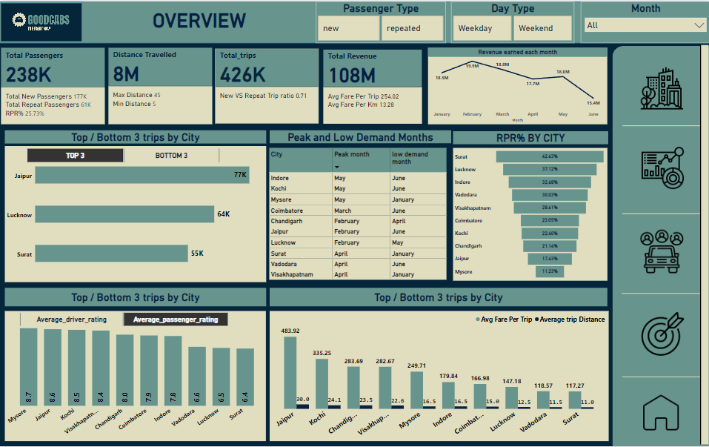
Dashboard

Slide 7
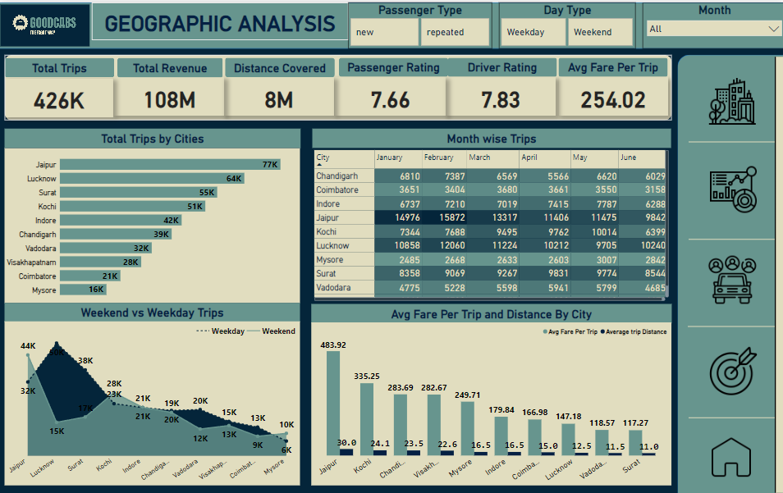
reports

Slide 8
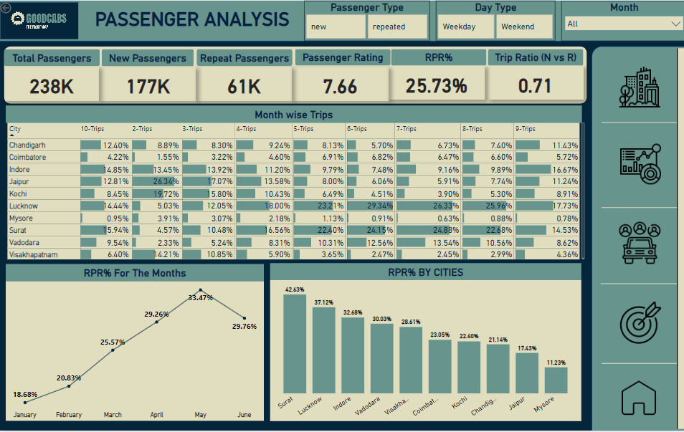
reports

Slide 9
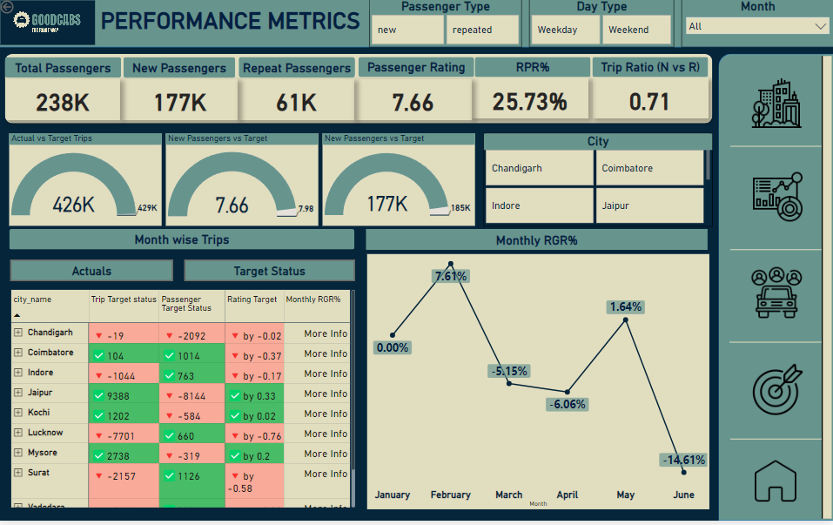
reports

Slide 10
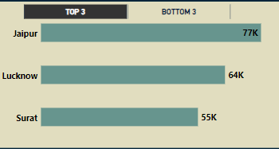
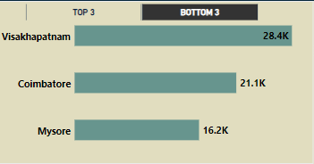
Primary questions
1. Top & Bottom Performing Cities
Identify the top 3 and bottom 3 cities by total trips over the entire analysis period.

Slide 11
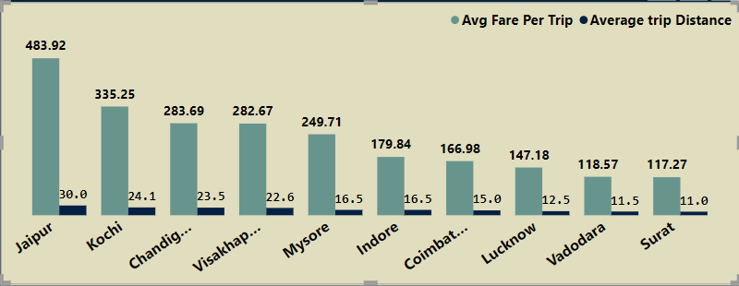
Primary questions
2. Average Fare Per Trip by City & compare it with the cities Average Trip Distance.

Slide 12
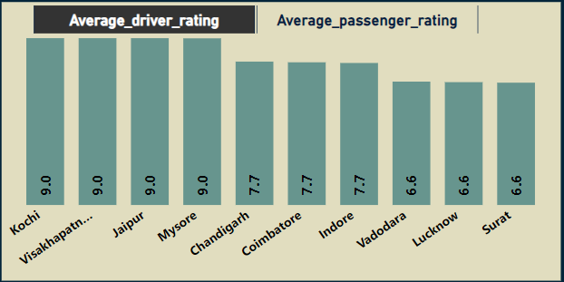
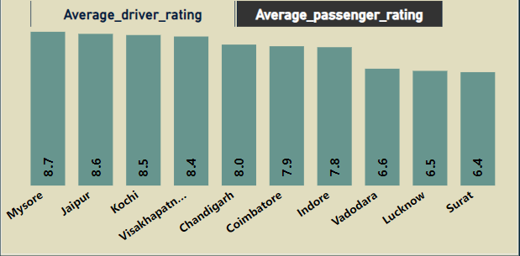
Primary questions
3. Average Passenger & Driver Ratings By City

Slide 13
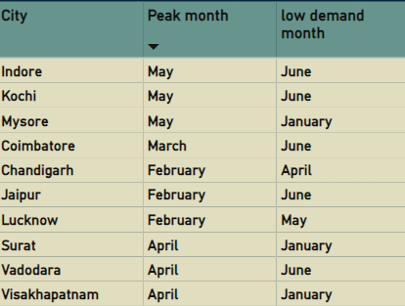
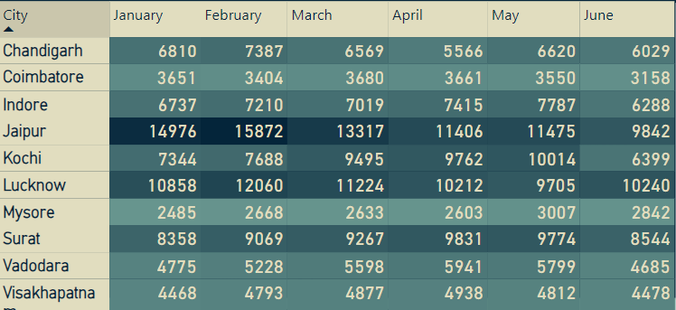
Primary questions
4. Peak & Low Demand Months by City
For each city, identify the month with the highest total trips and the month with the lowest total trips.

Slide 14
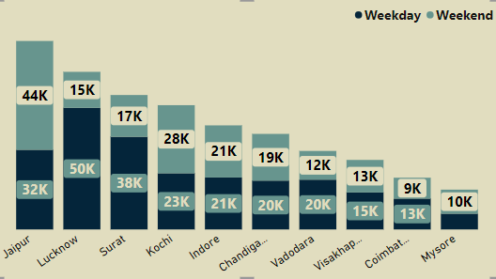
Primary questions
5. Weekend vs. Weekday Trip Demand by City

Slide 15
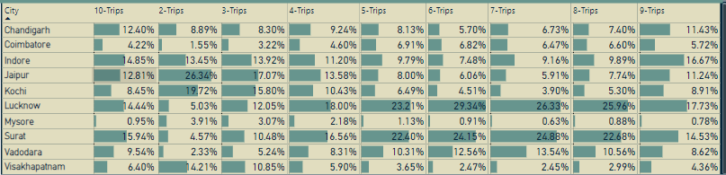
Primary questions
6. Repeat passenger frequency and City contribution Analysis

Slide 16
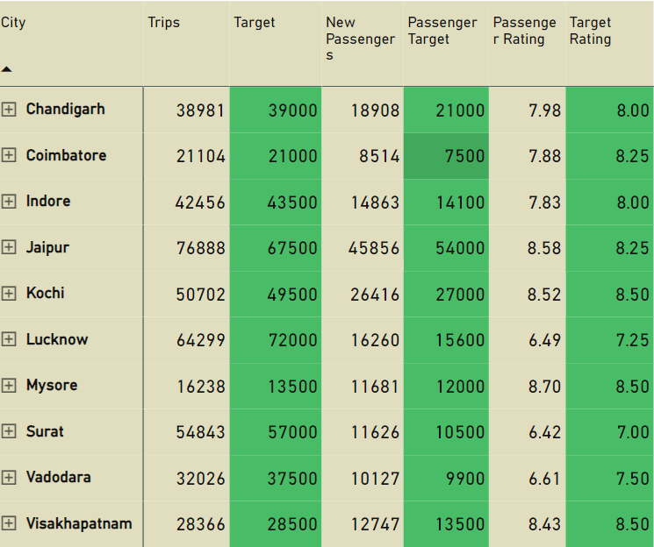
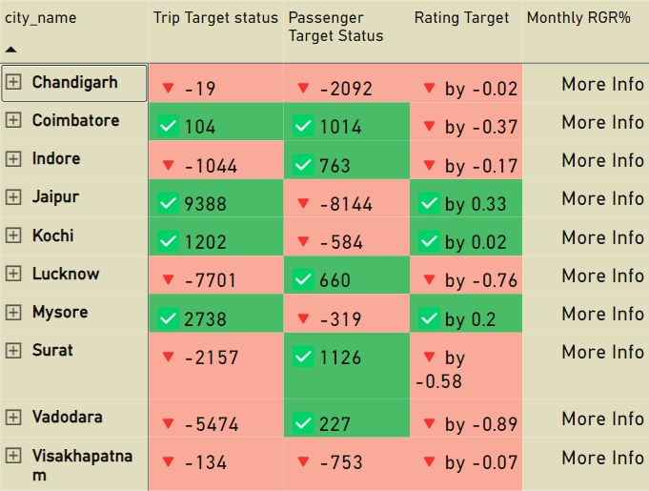
Primary questions
7. Monthly Target Achievement Analysis for Key Metrics

Slide 17
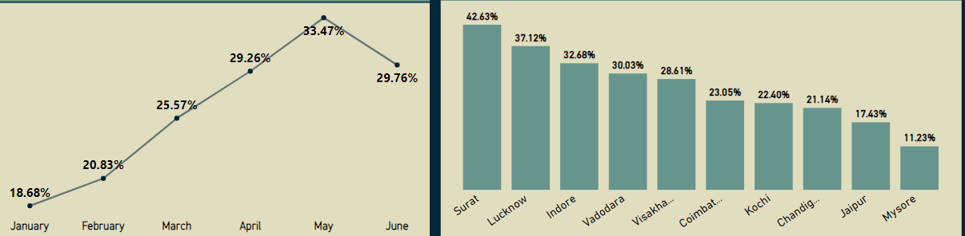
Primary questions
7. Highest & Lowest Repeat Passenger Rate (RPR%) By City and Month

Slide 18
Secondary questions
1. What factors (such as quality of service, competitive pricing, or city demographics) might contribute to higher or lower repeat passenger rates in different cities? Are there correlations with socioeconomic or lifestyle patterns in these cities?
High Repeat Passenger Cities - Surat, Lucknow, Indore
Affordable Fares: Lower fares (Surat: ₹117, Lucknow: ₹147, Indore: ₹179) attract budget-conscious daily commuters.
Service Quality: Moderate ratings (6–7/10) are sufficient for passengers prioritizing affordability over luxury.
Demographics & Socioeconomics: Predominantly middle-class populations and daily commuters drive repeat usage.
Low Repeat Passenger Cities - Mysore, Jaipur
High Fares: Higher fares (Jaipur: ₹483, Mysore: ₹249) limit repeat usage to premium customers.
Service Quality: High ratings (Mysore: 8.7, Jaipur: 8.6) appeal to tourists seeking comfort and reliability.
Demographics & Socioeconomics: Tourist-heavy cities with affluent passengers focus on short-term, premium services.

Slide 19
Secondary questions
3. What emerging mobility trends (such as electric vehicle adoption, green energy use) are impacting the cab service market in tier-2 cities? Should Goodcabs consider integrating electric vehicles or eco-friendly initiatives to stay competitive?
Integrate Electric Vehicles (EVs): Transitioning part of the fleet to EVs can reduce operational costs, attract environmentally conscious passengers, and align with government sustainability initiatives.
Eco-Friendly Initiatives:
Introduce green branding by promoting EV rides and carbon offset programs.
Partner with renewable energy providers to install EV charging stations.
Leverage Market Trends:
Offer discounts or loyalty programs for passengers choosing eco-friendly rides.
Highlight sustainability efforts in marketing campaigns to enhance brand appeal.
These initiatives can position GoodCabs as a forward-thinking, eco-conscious brand, ensuring competitiveness in tier-2 cities.

Slide 20
secondary QUESTIONS
4. To make Goodcabs more data-driven and improve its performance across key metrics (such as repeat passenger rate, customer satisfaction, new passengers and trip volume), what additional data should Goodcabs collect? Consider data that could provide deeper insights into customer behaviour, operational efficiency, and market trends
Operational Efficiency & Driver Performance:
Driver Metrics: Average trip time, customer ratings.
Cancellations & Delays: Reasons for delays.
Vehicle Maintenance: Data and health tracking.
Trip Optimization: Real-time route efficiency.
Customer Behavior & Preferences:
Trip Frequency & Timing: Peak hours, weekdays vs weekends.
Ride Preferences: Car type, special requests.
Customer Profiles: Age, location, income.
Feedback: Post-trip surveys, NPS.
Market Trends & Competitive Insights :
Competitive Pricing: Comparing fares.
Demand-Supply Balance: Fleet availability.
Market Sentiment: Reviews and social media.
Promotions: Effectiveness of referral programs.
Revenue & Trip Volume Metrics :
Revenue per Trip: Average fare by ride type, time, location.
Utilization Rates: Fleet efficiency.
Payment Preferences: Digital vs cash.
Trip Volume Analysis: By time of day, location, customer type.

Slide 21
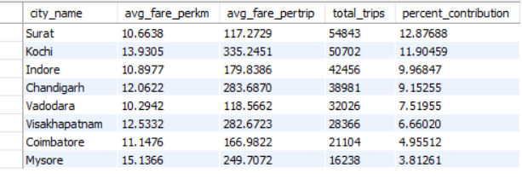
Ad hoc requests
City Level Fare & Trip Summary Report :

Slide 22
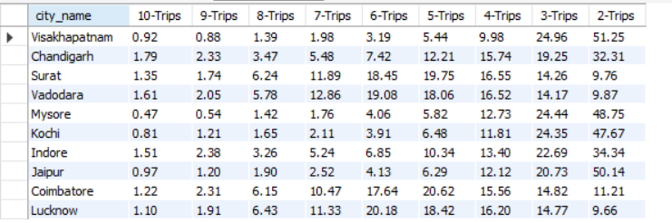
Ad hoc requests
City Level Repeated Passenger Trip Frequency Report :

Slide 23
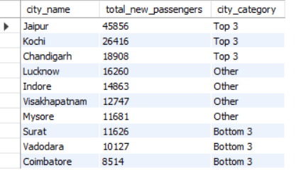
Ad hoc requests
Identify the Cities With the Highest & Lowest Total New Passengers :

Slide 24
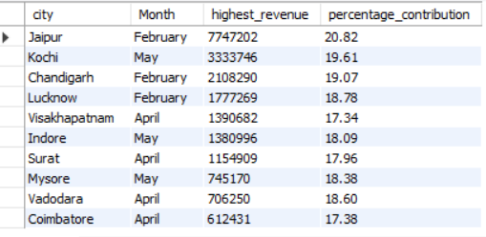
Ad hoc requests
Identify the Cities with Highest Revenue Month & % Contribution :

Slide 25
recommendations
1. Refine Fare Strategies:
Focus on Emerging Cities: Lower fares in cities with high potential but low repeat bookings (e.g., Mysore, Jaipur) to attract cost-conscious travelers and increase customer retention.
Variable Pricing: Adopt a flexible pricing model that adjusts according to demand fluctuations (e.g., peak hours, holidays), ensuring optimal revenue while keeping loyal customers satisfied.
2. Promote Sustainable Practices:
Electric Vehicle Adoption: Deploy electric vehicles in cities where EV infrastructure is already in place (e.g., Bengaluru, Delhi) to lower operating expenses and enhance the brand’s eco-friendly image.
Eco-Friendly Rides: Introduce “Green Ride” options to attract environmentally conscious passengers, setting Goodcabs apart from competitors and bolstering its sustainability initiatives.
3. Forge Strategic Alliances:
Retail Partnerships: Team up with popular retail locations like shopping malls, hotels, and event venues in high-traffic areas (e.g., Mumbai, Chennai) to boost ride demand through exclusive offers or discounts.
Corporate Collaborations: Establish partnerships with companies in business-driven cities (e.g., Lucknow, Indore) to secure consistent ride volume, offering discounted rates or special plans for corporate employees.
4. Boost Customer Engagement:
Rewards Program: Roll out a customer loyalty initiative with benefits such as free rides, reduced fares, or priority access for frequent users, encouraging repeat bookings and fostering customer loyalty.
Customized Offerings: Leverage customer data to create personalized promotions, ride suggestions, or tailored packages based on individual preferences, improving satisfaction and boosting long-term engagement.
5. Enhance Service Quality:
Driver Development: Offer comprehensive training for drivers to improve service quality in cities with moderate ratings (e.g., those with ratings between 6 and 7), focusing on better communication, safety, and customer interaction.
Customer Feedback Loop: Establish a robust system for collecting and analyzing passenger feedback, ensuring continuous improvements to service delivery and responding quickly to areas requiring attention.

